Slide 1
Computer Algorithms
Segment 6
Shortest Path

Slide 2
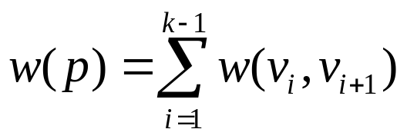
SINGLE-SOURCE SHORTEST PATHS
Generalization of BFS to handle weighted graphs
Direct Graph G = ( V, E ), edge weight function; w : E → R
In BFS w(e)=1 for all e Î E
Weight of path p = v₁ → v₂ → … → v_{k} is
Shortest Path = Path of minimum weight
δ(u,v)=
p
min{w(p):u v}; if there is a path from u to v,
∞ otherwise.

Slide 3
Shortest-Path Variants
Shortest-Path problems
  Single-source shortest-paths problem: Find the shortest path from s to each vertex v. (e.g. BFS)
  Single-destination shortest-paths problem: Find a shortest path to a given destination vertex t from each vertex v.
  Single-pair shortest-path problem: Find a shortest path from u to v for given vertices u and v.
  All-pairs shortest-paths problem: Find a shortest path from u to v for every pair of vertices u and v.

Slide 4
Optimal Substructure Property
Theorem: Subpaths of shortest paths are also shortest paths
Let P_{1k} = <v₁, ... ,v_{k} > be a shortest path from v₁ to v_{k}
Let P_{ij} = <v_{i}, ... ,v_{j} > be subpath of P_{1k} from v_{i} to v_{j}
for any i, j
Then P_{ij} is a shortest path from v_{i} to v_{j}
Proof: By cut and paste
If some subpath were not a shortest path
We could substitute a shorter subpath to create a shorter total path
Hence, the original path would not be shortest path
v₀
v₁
v₂
v₃
v₄
v₅
v₆
v₇

Slide 5
Optimal Substructure Property
Definition:
δ(u,v) = weight of the shortest path(s) from u to v
Well Definedness:
negative-weight cycle in graph: Some shortest paths may not be defined
argument:can always get a shorter path by going around the cycle again
χψχλε
< 0
σ
ϖ

Slide 6
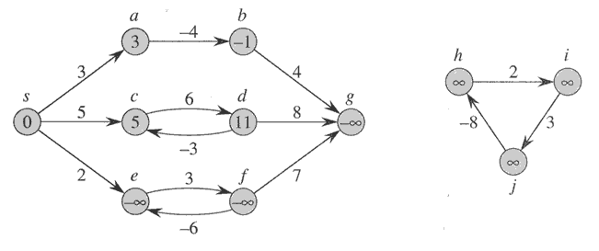
Negative-weight edges
Negative weight edges can be allowed as long as there are no negative weight cycles
If there are negative weight cycles, then there cannot be a shortest path from s to any node t (why?)
If we disallow negative weight cycles, then there always is a shortest path that contains no cycles
No problem, as long as no negative-weight cycles are reachable from the source
Otherwise, we can just keep going around it, and
get w(s, v) = −∞ for all v on the cycle.

Slide 7
Relaxation technique
For each vertex v, we maintain an upper bound d[v] on the weight of shortest path from s to v
d[v] initialized to infinity
Relaxing an edge (u,v)
  Can we improve the shortest path to v by going through u?
  If d[v] > d[u] + w(u,v), d[v] = d[u] + w(u,v)
  This can be done in O(1) time
u
v
u
v
2
2
5
9
5
6
Relax(u,v)
Relax(u,v)
5
7
5
6
2
2
u
v
u
v

Slide 8
Relaxation
Algorithms keep track of d[v], π[v]. Initialized as follows:
Initialize(G, s)
for each v ∈ V[G] do
d[v] := ∞;
π[v] := NIL
d[s] := 0
These values are changed when an edge (u, v) is relaxed:
Relax(u, v, w)
if d[v] > d[u] + w(u, v) then
d[v] := d[u] + w(u, v);
π[v] := u
//Reference: Introduction to algorithm-CORMEN, page 585, 586

Slide 9
Properties of Relaxation
Triangle inequality
for a given vertex s Î V and for every edge (u,v) Î E,
we have δ(s,v) ≤ δ(s,u) + w(u,v)
Upper-bound property
We always have d[v] ≥ δ(s, v) for all vertices v ÎV, and once d[v] achieves the value δ(s, v), it never changes.
No-path property
If there is no path from s to v, then d[v] = δ(s, v) = ∞.
Convergence property
If s u →v is a shortest path in G for some u, v ÎV, and if
d[u] = δ(s, u) at any time prior to relaxing edge (u, v), then
d[v] = δ(s, v) at all times afterward.
Path-relaxation property

Slide 10
Bellman-Ford Algorithm
Can have negative-weight edges. Will “detect” reachable negative-weight cycles.
Given a weighted, directed graph G=(V,E) with source s and weight function w : E→R, the Bellman-Ford algorithm returns a Boolean value indicating whether or not there is a negative-weight cycle that is reachable from the source.
Bellman-Ford(G, w, s)
Initialize(G, s);
for i := 1 to |V[G]| –1 do
for each (u, v) in E[G] do
Relax(u, v, w)
for each (u, v) in E[G] do
if d[v] > d[u] + w(u, v) then
return false
return true
Time
Complexity
is O(VE).
d and π values are the final
values
//Reference: Introduction to algorithm-CORMEN, page 588, 586

Slide 11
Bellman-Ford Algorithm (cont.)
t
5
x
t
5
x
∞
-2
∞
6
-2
∞
6
6
-3
-3
s
0
8
s
0
8
-4
7
-4
7
2
2
7
7
∞
∞
7
∞
9
9
y
z
y
z
(a)
(b)
t
5
x
t
5
x
6
-2
4
-2
6
6
2
4
-3
-3
s
0
8
s
0
8
-4
7
-4
7
2
2
7
7
7
2
7
2
9
9
y
z
y
z
(c)
(d)

Slide 12
Bellman-Ford Algorithm (cont.)
t
x
2
-2
4
6
5
-3
s
0
8
-4
7
2
7
d and π values in (e) are the final
values
7
−2
9
y
z
(e)
Bellman-Ford running time:
  (|V|-1)|E| + |E| = Θ(VE)

Slide 13
Dijkstra’s Algorithm For Shortest Paths
Non-negative edge weight
Like BFS: If all edge weights are equal, then use BFS, otherwise use this algorithm
Use Q = priority queue keyed on d[v] values (note: BFS uses FIFO)
Dijkstra(G,w,s)
Initialize(G, s);
S := ∅;
Q := V[G];
while Q ≠ ∅ do
u := Extract-Min(Q);
S := S ∪ {u};
for each v ∈ Adj[u] do
Relax(u, v, w)
//Reference: Introduction to algorithm-CORMEN, page 595

Slide 14
Dijkstra’s Algorithm For Shortest Paths
u
v
u
v
1
1
10
∞
∞
10
10
∞
9
9
s
0
2
3
s
0
2
3
4
6
4
6
7
7
5
5
∞
∞
5
∞
2
2
x
y
x
y
(a)
(b)
u
v
u
v
1
1
10
8
14
10
8
13
9
9
s
0
2
3
s
0
2
3
4
6
4
6
7
7
5
5
5
7
5
7
2
2
x
y
x
y
(c)
(d)

Slide 15
Dijkstra’s Algorithm For Shortest Paths
u
v
u
v
1
1
10
8
9
10
8
9
9
9
0
2
3
0
2
3
4
6
4
6
7
7
5
5
5
7
5
7
2
2
x
y
x
y
(e)
(f)
d and π values in (f) are the final
values

Slide 16
Running Time Analysis cont’d
O(E) edge relaxations
Priority Queue operations
  O(E) decrease key operations
  O(V) extract-min operations
Three implementations of priority queues
  Array: O(V²) time
    decrease-key is O(1) and extract-min is O(V)
  Binary heap: O(E log V) time assuming E >= V
    decrease-key and extract-min are O(log V)
  Fibonacci heap: O(V log V + E) time
    decrease-key is O(1) amortized time and extract-min is O(log V)
Running time of Dijkstra’s algorithm is lower than that of Bellman-Ford algorithm

Slide 17
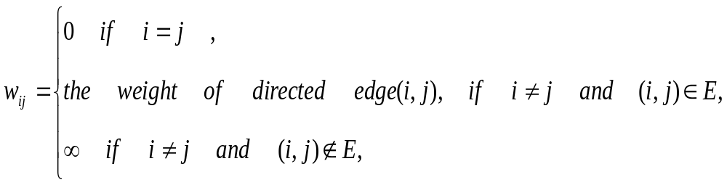
All-Pairs Shortest Paths
We now want to compute a table giving the length of the shortest path between any two vertices. (We also would like to get the shortest paths themselves.)
Assume input graph is given by an adjacency matrix.
    W = (w_{ij}) where
Let d_{ij}^{(m)} = minimum weight of any path from vertex i to vertex j,
containing at most m edges.

Slide 18
Dynamic programming algorithms for all-pairs shortest path
We will study a new technique—dynamic programming algorithms (typically for optimization problems)
Ideas:
  Characterize the structure of an optimal solution
  Recursively define the value of an optimal solution
  Compute the value of an optimal solution in a bottom-up fashion (using matrix to compute)
  Backtracking to construct an optimal solution from computed information.

Slide 19
Floyd-Warshall algorithm for shortest path:
Use a different dynamic-programming formulation to solve the all-pairs shortest-paths problem on a directed graph G=(V,E).
The resulting algorithm, known as the Floyd-Warshall algorithm, runs in O (V³) time.
  negative-weight edges may be present,
  but we shall assume that there are no negative-weight cycles.

Slide 20
The structure of a shortest path:
We use a different characterization of the structure of a shortest path than we used in the matrix-multiplication-based all-pairs algorithms.
The algorithm considers the “intermediate” vertices of a shortest path, where an intermediate vertex of a simple path p=<v₁,v₂,…,v_{l}> is any vertex in p other than v₁ or v_{l}, that is, any vertex in the set {v₂,v₃,…,v_{l-1}}

Slide 21
Continue:
Let the vertices of G be V={1,2,…,n}, and consider a subset {1,2,…,k} of vertices for some k.
For any pair of vertices i,j ∈ V, consider all paths from i to j whose intermediate vertices are all drawn from {1,2,…,k},and let p be a minimum-weight path from among them.
The Floyd-Warshall algorithm exploits a relationship between path p and shortest paths from i to j with all intermediate vertices in the set {1,2,…,k-1}.

Slide 22
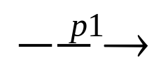
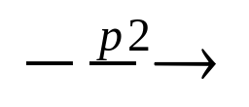
Relationship:
The relationship depends on whether or not k is an intermediate vertex of path p.
If k is not an intermediate vertex of path p, then all intermediate vertices of path p are in the set {1,2,…,k-1}. Thus, a shortest path from vertex i to vertex j with all intermediate vertices in the set {1,2,…,k-1} is also a shortest path from i to j with all intermediate vertices in the set {1,2,…,k}.
If k is an intermediate vertex of path p,then we break p down into i k j as shown Figure 2.p1 is a shortest path from i to k with all intermediate vertices in the set {1,2,…,k-1}, so as p2.

Slide 23
All intermediate vertices in {1,2,…,k-1}
p1
k
p2
i
j
P:all intermediate vertices in {1,2,…,k}
Figure2. Path p is a shortest path from vertex i to vertex j,and
k is the highest-numbered intermediate vertex of p. Path p1,
the portion of path p from vertex i to vertex k,has all intermediate
vertices in the set {1,2,…,k-1}.The same holds for path p2 from
vertex k to vertex j.

Slide 24




A recursive solution to the all-pairs shortest paths problem:
Let d_{ij}^{(k)} be the weight of a shortest path from vertex i to vertex j with all intermediate vertices in the set {1,2,…,k}. A recursive definition is given by
d_{ij}^{(k)}= w_{ij} if k=0,
min(d_{ij}^{(k-1)},d_{ik}^{(k-1)}+d_{kj}^{(k-1)}) if k 1.
The matrix D^{(n)}=(d_{ij}^{(n)}) gives the final answer-d_{ij}^{(n)}= for all i,j V-because all intermediate vertices are in the set {1,2,…,n}.

Slide 25
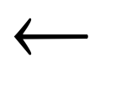
Computing the shortest-path weights bottom up:
FLOYD-WARSHALL(W)
n rows[W]
D⁽⁰⁾ W
for k 1 to n
do for i 1 to n
do for j 1 to n
d_{ij}^{(k)} min(d_{ij}^{(k-1)},d_{ik}^{(k-1)}+d_{kj}^{(k-1)})
return D^{(n)}

Slide 26
Example:
Figure 3
2
4
3
1
3
8
1
-4
-5
7
2
5
4
6

Slide 27
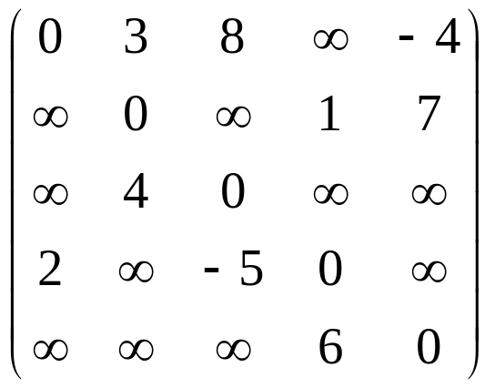
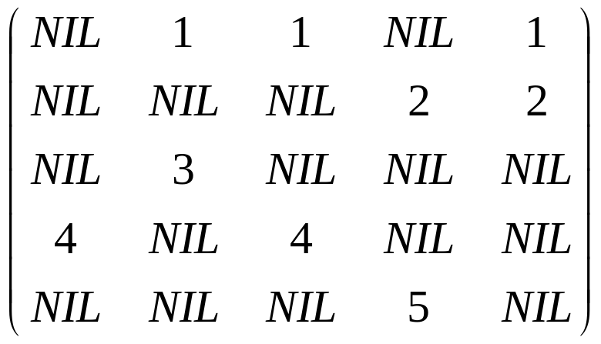

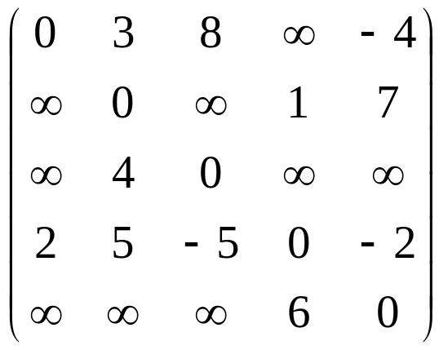
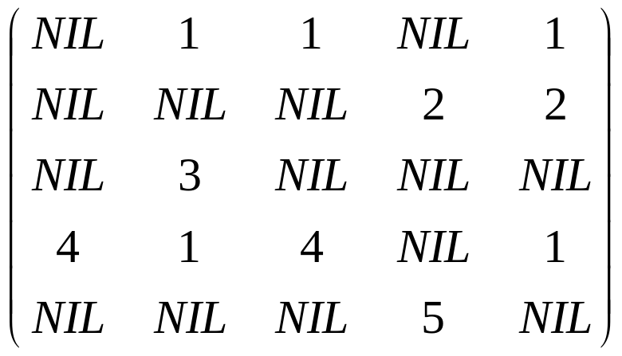
D(0)=
(0)=
D(1)=
(1)=

Slide 28
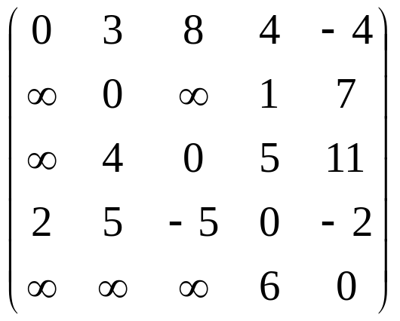
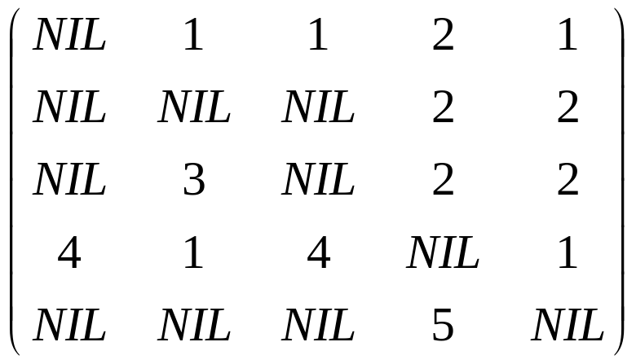
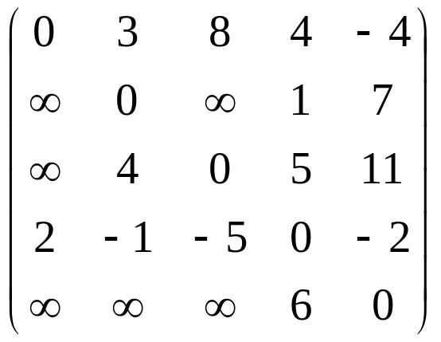

D(2)=
(2)=
D(3)=
(3)=

Slide 29
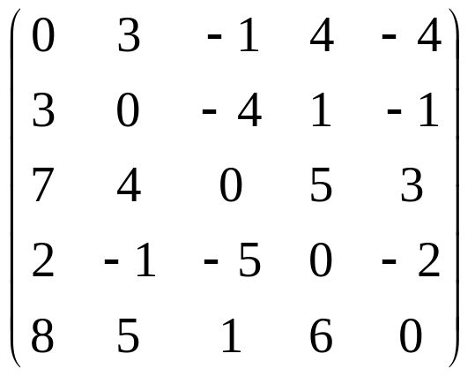
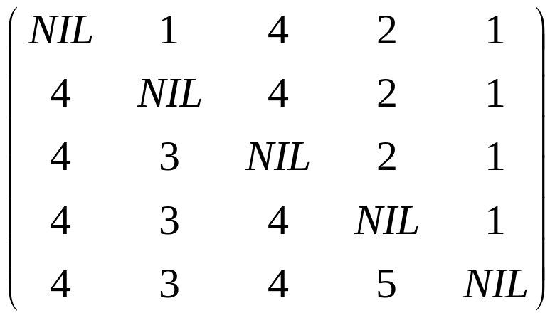
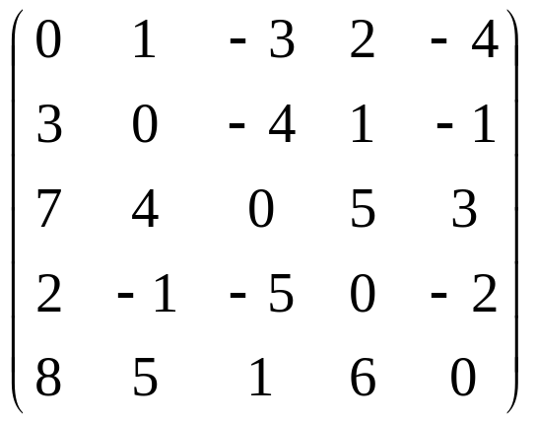
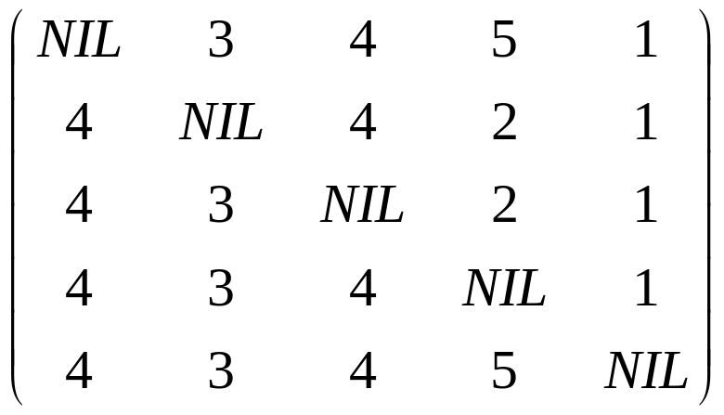
D(4)=
(4)=
D(5)=
(5)=

Slide 30
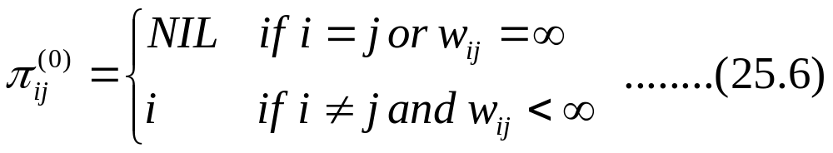

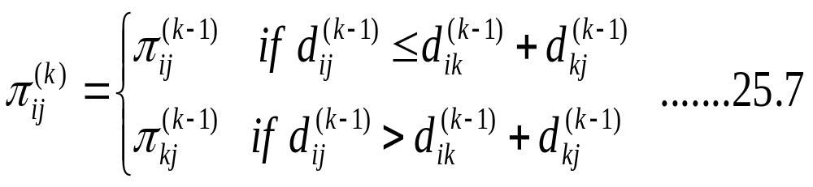
  Constructing a shortest path:
  π_{ij}^{(k)} : the predecessor of vertex j on a shortest path from i with all intermediate vertices in the set {1, 2, …, k}

Slide 31


Print a shortest path from vertex i to vertex j
Print-All-Pairs-Shortest-Path(Π, i,j)
if i=j
then print i
else if
then print “no path from” i “to” j “exists”
else Print-All-Pairs-Shortest-Path(Π, i, )
print j

